Slide 1
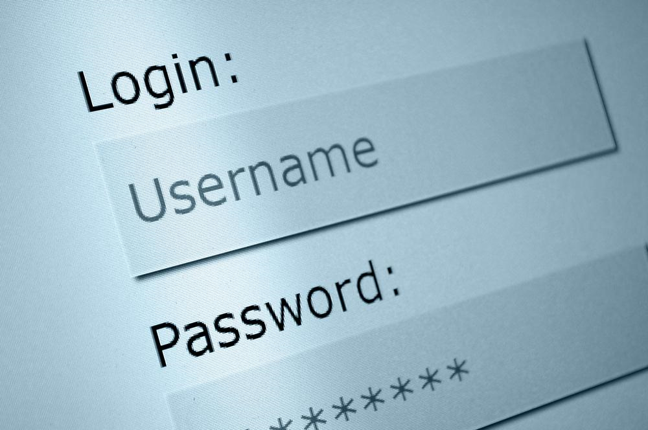
You think you are safe?
Notes:
…What is Game AI?...
…Many think that game AI is just there to be the enemy…
…that may have been true in the past, but now AI does much more than that…
…AI tries to imitate believable behavior in Non-Player Characters (NPCs)…
…Make the game world come alive…
…show that the world of the game could actually exist…
…CLICK…

Slide 2
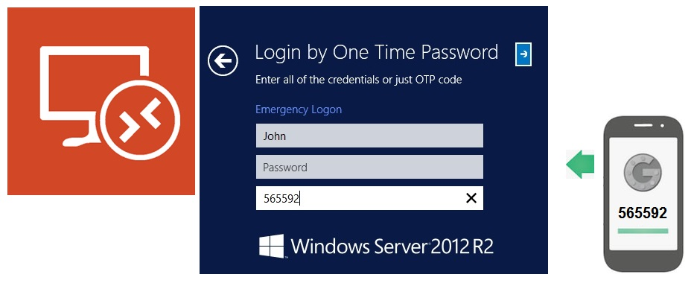
Can two-factor authentication resolve “user factor” problem?
Notes:
…What is Game AI?...
…Many think that game AI is just there to be the enemy…
…that may have been true in the past, but now AI does much more than that…
…AI tries to imitate believable behavior in Non-Player Characters (NPCs)…
…Make the game world come alive…
…show that the world of the game could actually exist…
…CLICK…

Slide 3
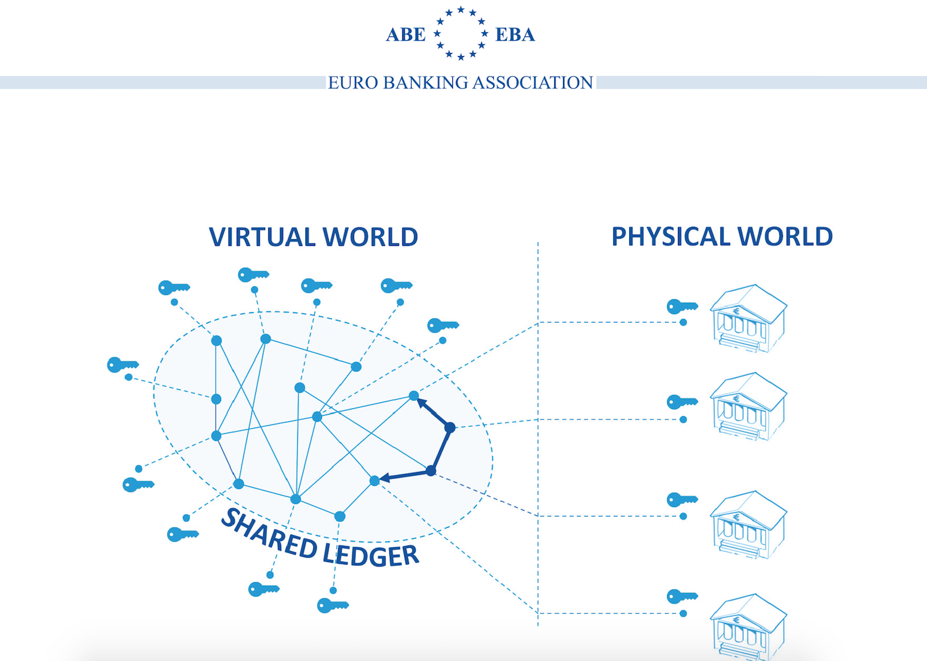
Can blockchain technology help with “user factor” issue?
Notes:
…What is Game AI?...
…Many think that game AI is just there to be the enemy…
…that may have been true in the past, but now AI does much more than that…
…AI tries to imitate believable behavior in Non-Player Characters (NPCs)…
…Make the game world come alive…
…show that the world of the game could actually exist…
…CLICK…

Slide 4
Is there a real solution?
Notes:
…What is Game AI?...
…Many think that game AI is just there to be the enemy…
…that may have been true in the past, but now AI does much more than that…
…AI tries to imitate believable behavior in Non-Player Characters (NPCs)…
…Make the game world come alive…
…show that the world of the game could actually exist…
…CLICK…

Slide 5
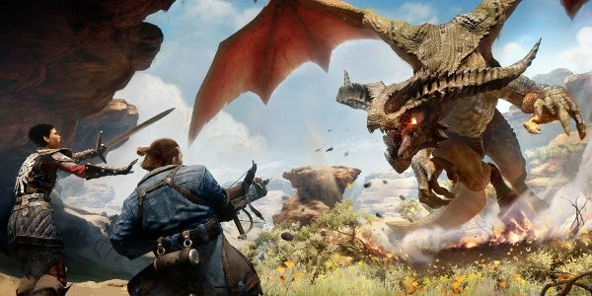
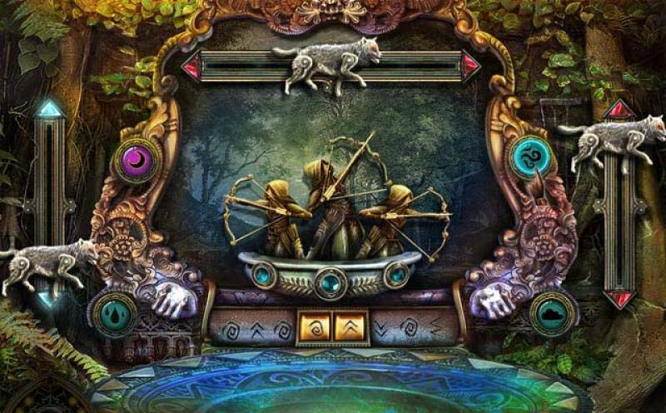
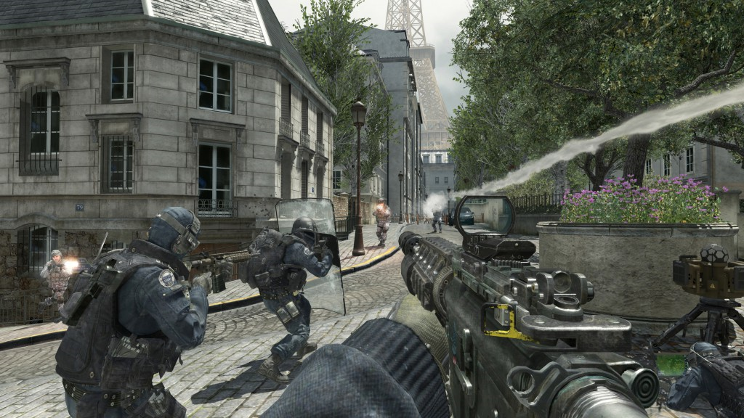
Interactive Security
Notes:
…What is Game AI?...
…Many think that game AI is just there to be the enemy…
…that may have been true in the past, but now AI does much more than that…
…AI tries to imitate believable behavior in Non-Player Characters (NPCs)…
…Make the game world come alive…
…show that the world of the game could actually exist…
…CLICK…

